Slide 1

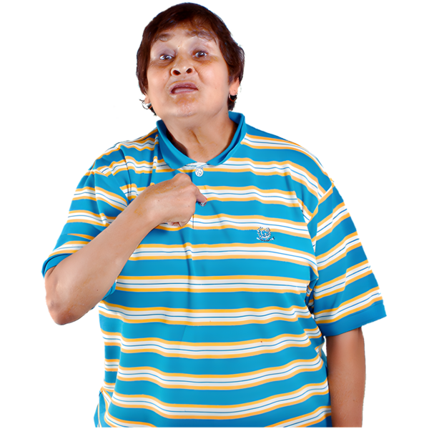



User Council Member- About the Role
What and who
The Advocacy Project is looking for one person to be a User Council Member
How long
The role will be for 2 years
After two years User Council Members can apply again
When
The User Council meets every two to three months
2 Months
3 Months

Slide 2
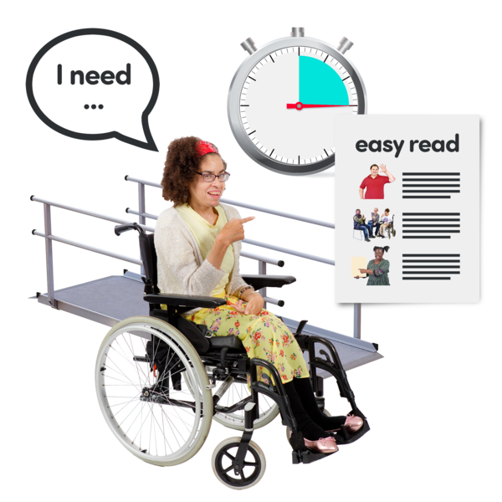
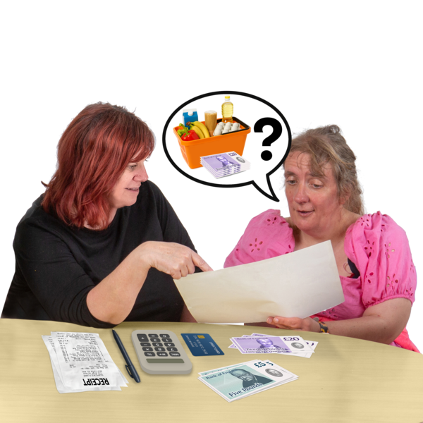


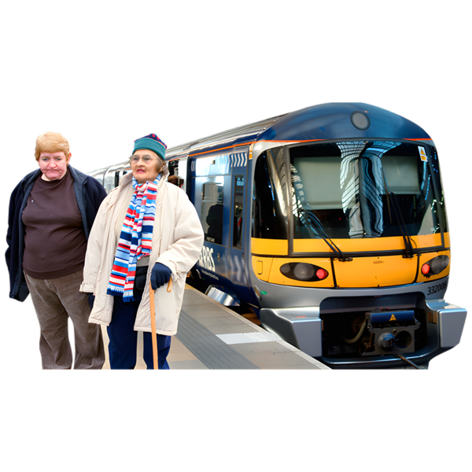
Meetings are usually in person. If you cannot attend in person, please talk to us
Payment
This is not a job. Reward and Recognition payments may affect benefits. We can tell you where to get advice.
We will pay you for going to meetings by bank transfer or voucher
We will pay you for cost of travel
Application Deadline
Please tell us you are interested by 31 August 2026
?

Slide 3


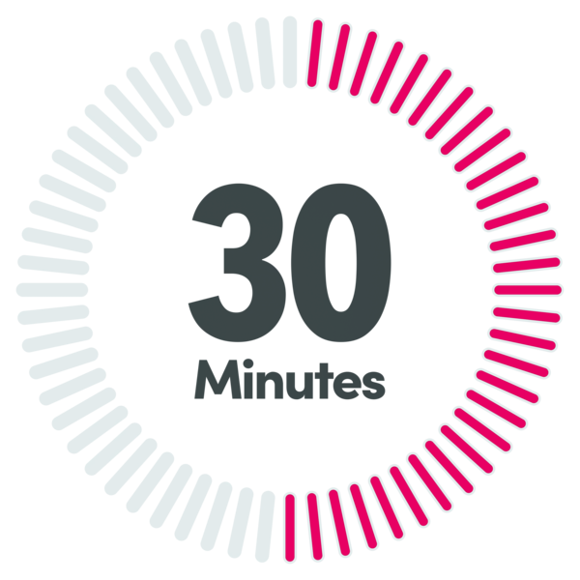
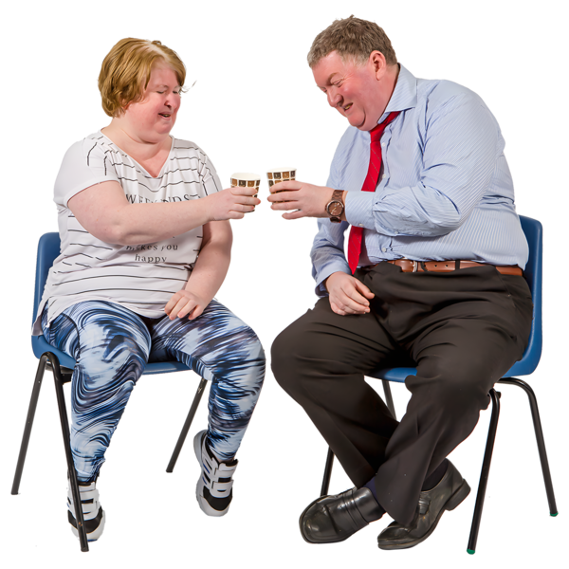
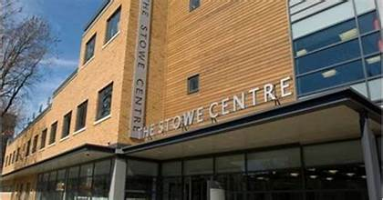

You might be asked to read leaflets to get ready for the meeting
The meeting can last up to 2 and a half hours
This includes a break
Where
Meetings are at The Stowe Centre
258 Harrow Road, London
W2 5ES
If we meet somewhere else we will tell you before

Slide 4
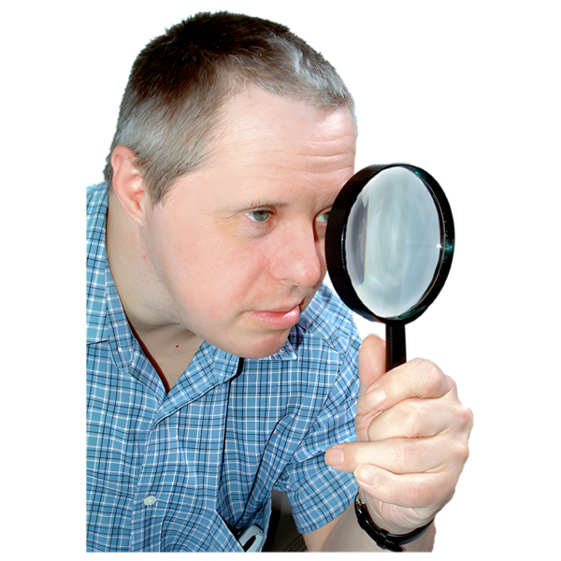

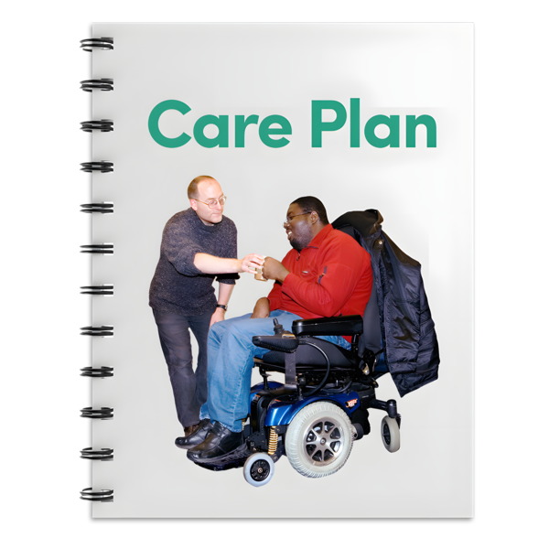
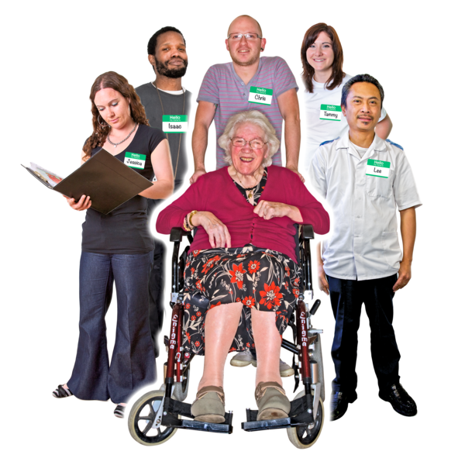
Who we are looking for
We are looking for someone who
Has used mental health services
or
Has used social care services
or
Has used older people's services

Slide 5
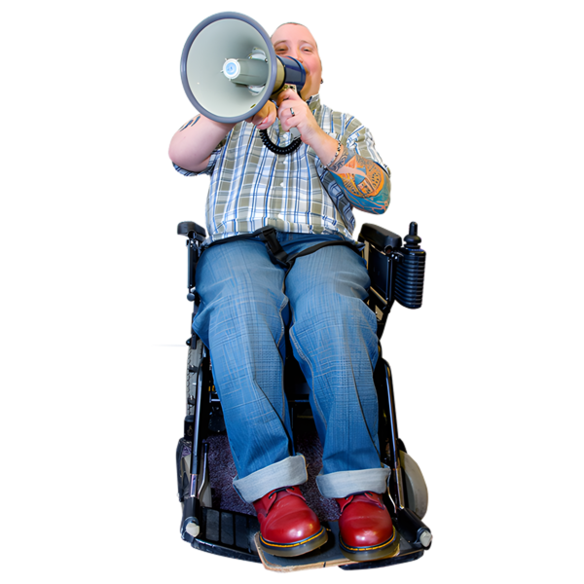

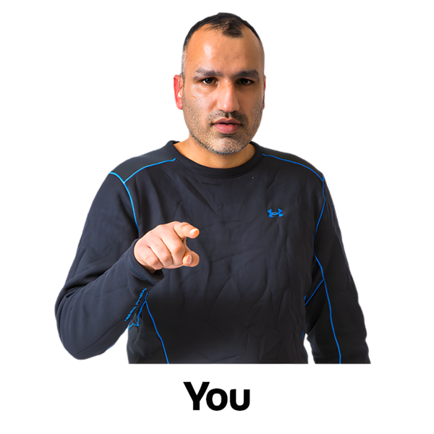
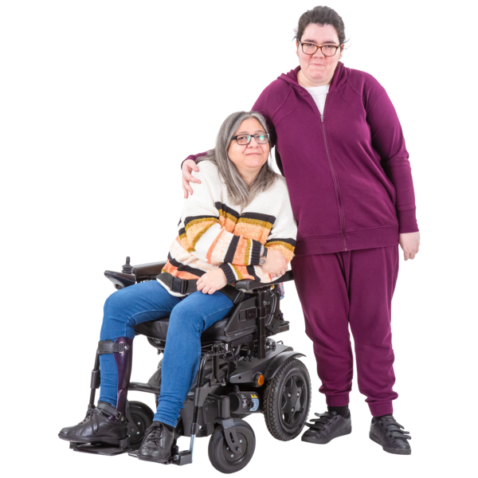
or
Has used Advocacy Services
or
Has used learning disability services
This could be your own experience
Or your experience as a parent or carer

Slide 6
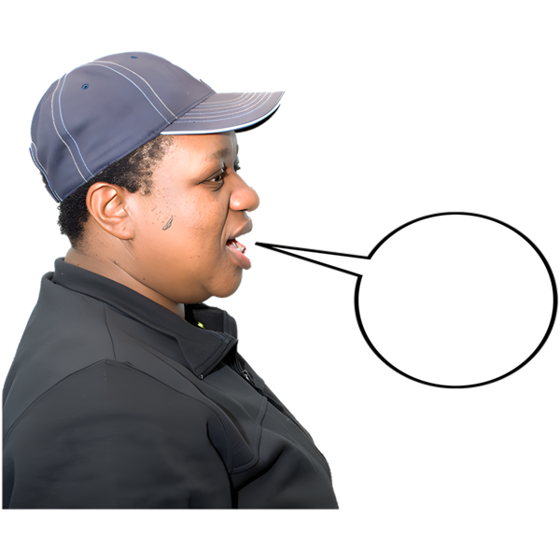
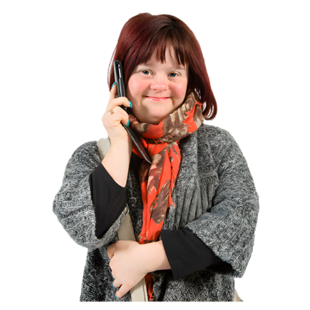

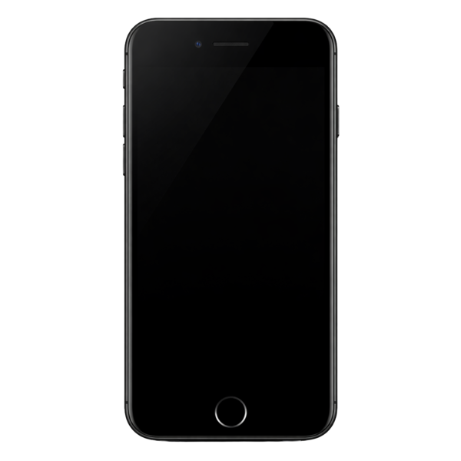
How to Apply
There is only one place on the User Council
You can tell us you are interested by:
Phoning us
Or sending a voice note

Slide 7
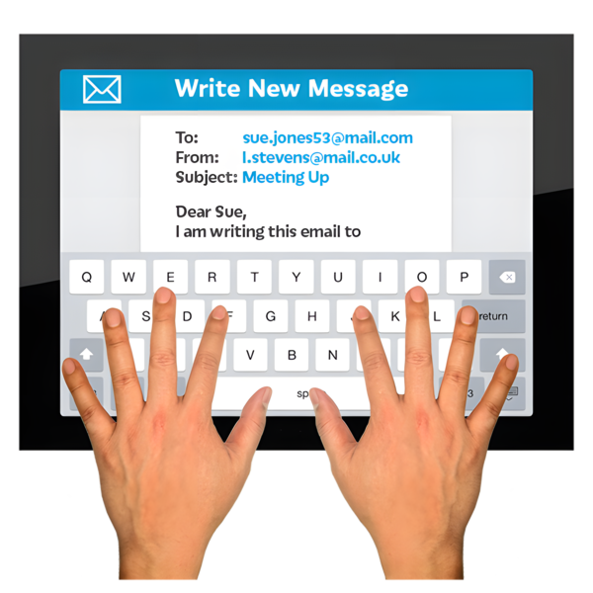
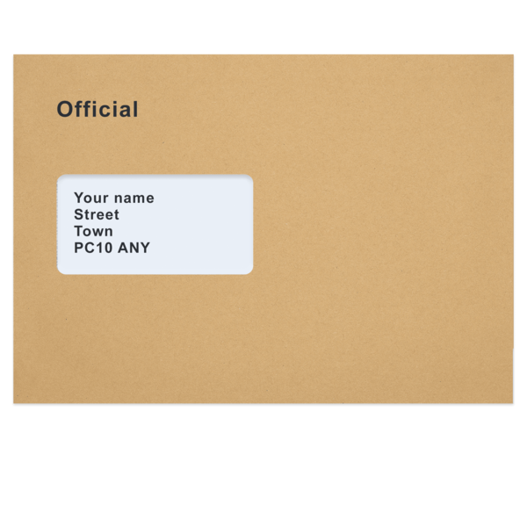
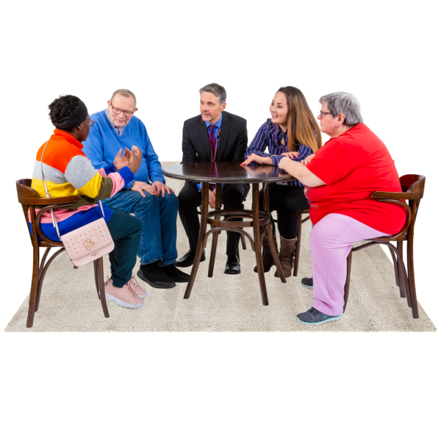


Or sending a short email or letter
Please tell us why you are interested in joining the User Council
What lived experience you would bring to the group
What you think helps people feel listened to and included

Slide 8
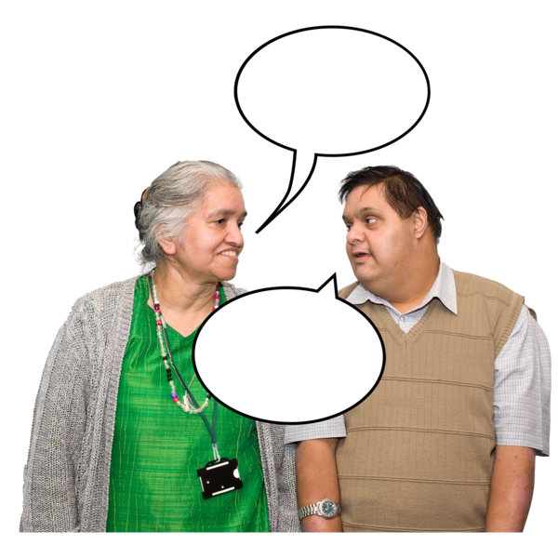

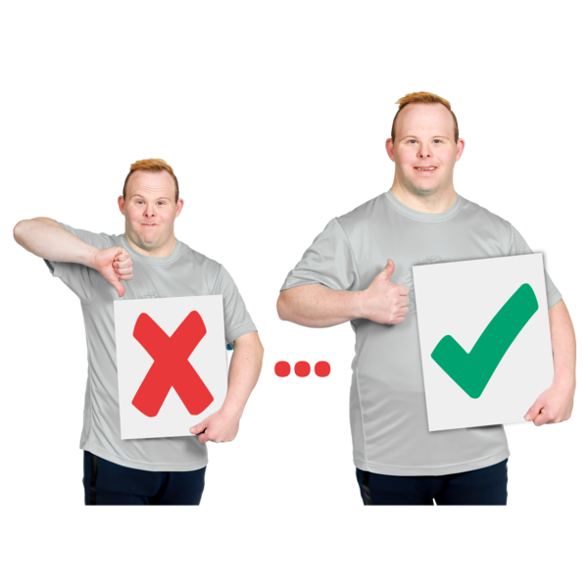

Tell us your experiences of
Sharing your point of view
Listening to others
Or helping make services better
Tell us about any support or reasonable adjustments you would need
You can use the role description to help you tell us

Slide 9

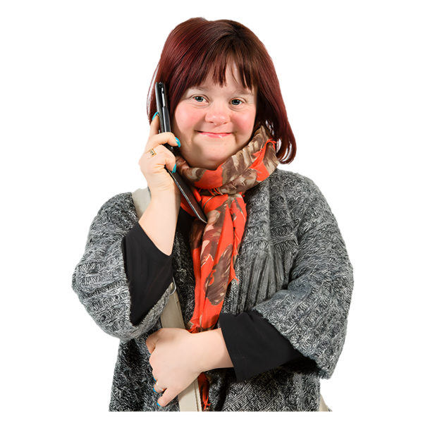
Contact Information
Who
Anna Lentz
Email
Anna.lentz@advocacyproject.org.uk
Phone Number
07983 210683

